Slide 1
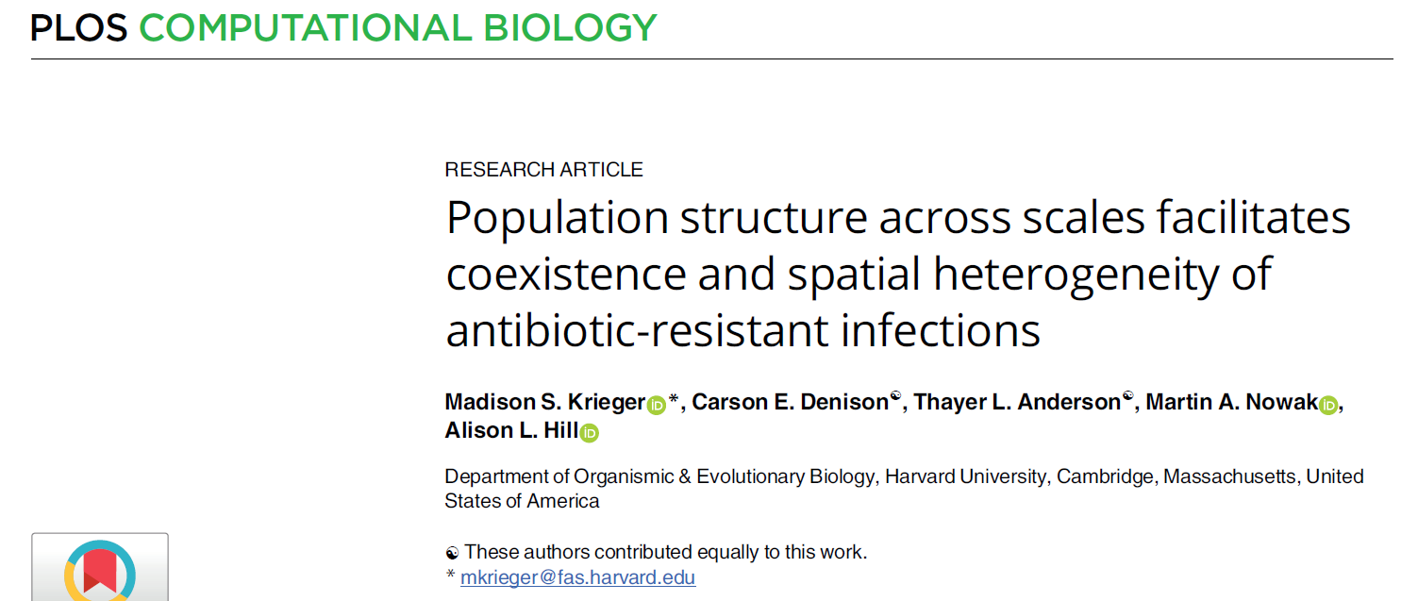

Slide 2
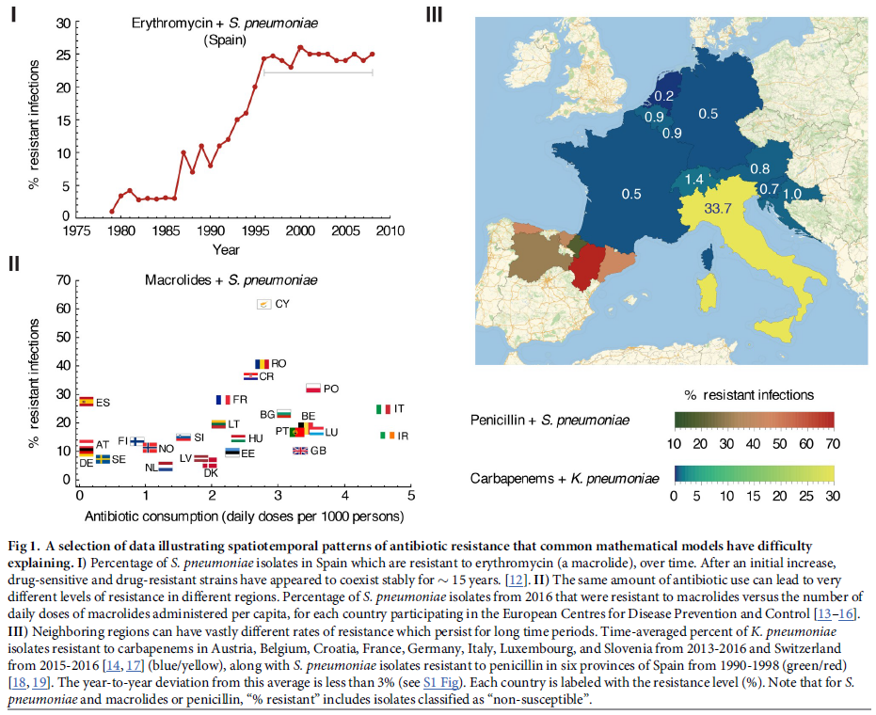
Introduction
Simple models of AMR evolution and transmission can not accurately replicate resistance dynamics and patterns of resistance:
Stable coexistence of resistant and sensitive strains
Countries with similar levels of usage have different levels of resistance
Nearby regions have different levels of resistance

Slide 3
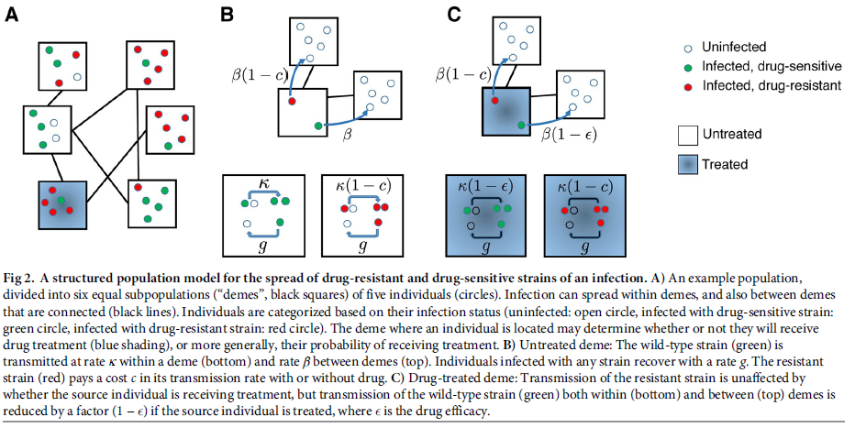
Methods
Mathematical model describes transmission of antibiotic-sensitive and antibiotic-resistant bacteria
Divide a population into sub-populations (or “demes”) to explore spatial heterogeneity
Use mathematical models to describe the transmission within (κ) and between (β) subpopulations
Treatment reduces treatment in antibiotic-sensitive strains (1-ε)
Resistance carries a fitness cost to transmission (1-c)
Sub-populations either treated or untreated.

Slide 4
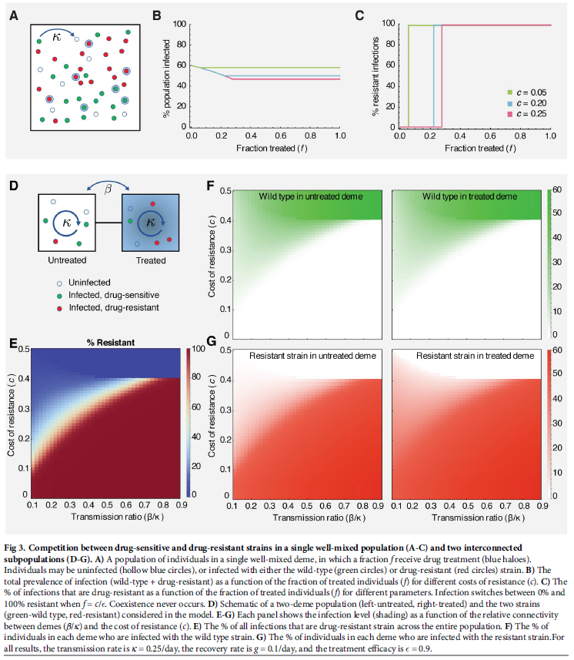
Results
Transmission in a homogenous population (no population structure)
Coexistence not possible
Dual population structure – sub-population either treated or untreated
Coexistence now possible
Across a range of different β/κ and c values (lower ratio means more coexistence)
Higher β/κ ratio – the population is more connected and homogenously mixing (greater levels of transmission between sub-populations)
c – cost of resistance (affects transmission)

Slide 5
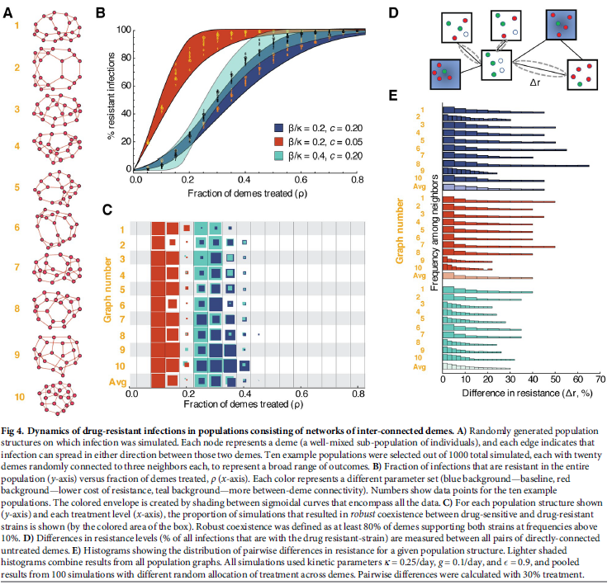
Results
Next they explored “networked” metapopulation model.
1A) Networked population - each population connected to 3 other subpopulations - tested for 10 different example networks
1B) Each network run for different parameter sets (varying in cost of resistance and connectivity β/κ).
Relationship between % resistant infections and fraction of populations treated - greater level of coexistence with greater cost of resistance and less connectivity.
1C) Testing for “robust” coexistence (defined as 80% demes with at least resistance above 10%)
Tested for different parameter sets and across the 10 networks – robust coexistence better with greater cost of resistance and lower connectivity
1D) Between untreated nodes identify differences in resistance levels (ΔR)
1E) Histogram of pairwise distances in resistance between untreated demes across all 10 networks for each parameter set
Greater differences found with greater cost of resistance and lower connectivity

Slide 6
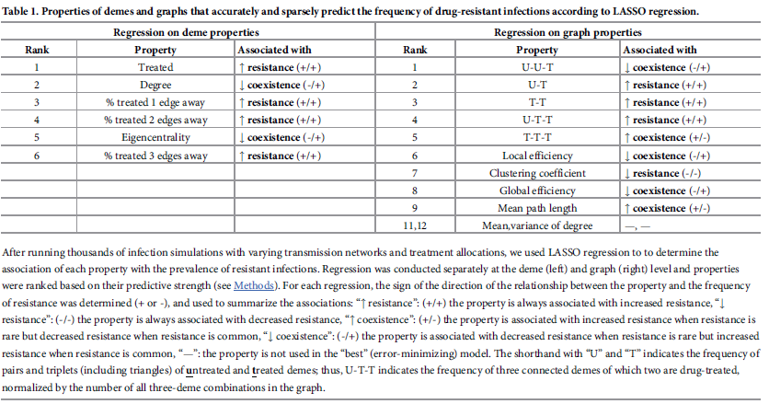
Results
LASSO regression – Least absolute shrinkage and selection operator
Identify characteristics which drive coexistence and resistance at the:
Left side – within deme properties
Right side – between deme properties
They also assessed if the property influenced resistance/co-existence in a frequency-dependent way
Notes:
Higher degree associated with lower resistance when resistance is rate but higher resistance when resistance is common – this makes sense since the more neighbours – the more opportunities
More interconnected hub like networks more likely to support the existence of the more common strain
More extreme clustering TTT supports coexistence rather than things being spread out

Slide 7
Results
Similar patterns found for coexistence and resistance when antibiotic treatment affects recovery and not transmission.
Variation in connectivity (variation in the size and the number of connections each deme has) produces similar patterns of co-existence and resistance
Variation in treatment across demes produces a similar results only when the differences in treatment between subpopulations is high.
When differences between treatment across demes is small – co-existence occurs within a much smaller treatment parameter space.
Alternative explanation for coexistence needed for this situation?

Slide 8
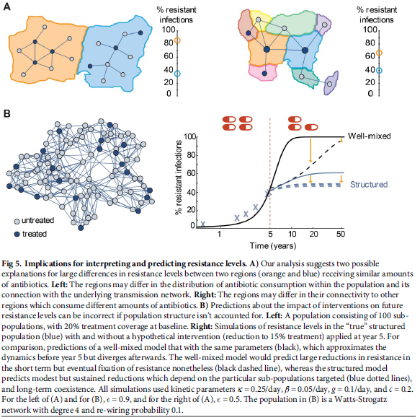
Discussion
1A) Potential explanations for the large differences in resistance between regions despite similar levels of antibiotics
Distribution of antibiotic usage may differ within a population
Connections to other regions may differ
1B) Model based predictions about future levels of resistance is often highly dependent on model structure
Structured population with 20% of the demes treated
Well mixed population predicts that a homogenously mixing population and a structured population have diverging dynamics

Slide 9
Discussion
Take Home Messages
Structured population models can recreate coexistence and some patterns of resistance.
Differences in connectivity, treatment distribution and costs of resistance can promote differences in the % resistance.
Well mixed population models can produce very different resistance dynamics to structured models.
Alternative explanations for variation in % resistance with similar antibiotic usage levels.
Prescribed vs consumed doses may be different.
Who actually receives the drug (heterogeneity in prescribing).
Genetic background of the pathogen.
Differences in transmission or recovery rate between region-specific strains.
Strain-specific control measures.

Slide 10
Relevance of the study?
Has relevance not just to resistant bacteria – but to other pathogens aswell: HIV, malaria etc.
Care must be taken with interpreting the dynamics – epidemiological situation is often different.
Usefulness of the study?
How much heterogeneity should you model? Community? Country?
How much data is required to parameterise this model for a real life case study?
Is the data realistically available to do this? How do we design a study to measure connectivity between subpopulations?
Do the methods make sense?
They used a basic model structure to describe a complex problem – often justified when data is limited
Results supported by a range of different studies in literature
General Strength and Weaknesses
Analysis is extremely thorough – large range of sensitvity analyses
Novel methodology to explore AMR dynamics
Model is simple, but enough for the study aims and objectives that they had.
Introduction and discussion sets the scene and explains the results very well.
They acknowledge the limitations of their results and don’t “oversell” them.
Model assumptions poorly explained and some parameter choices have 0 explanation
Methods are often confusing and poorly explained
Model not fitted to any form of data – although there is available data for it (in humans – Davies et al, 2019)
Could have used this to create baseline parameters which they can deviate from for sensitvity analysis
Are there better statistical tests than a LASSO analysis? Is this the most suitable?
Notes:
My thoughts on the study
A bit rough around the edges but shows an important concept and the methodology is very cool
Discussion extremely thorough
It’s difficult to go further until better data becomes available at the experimental and the epidemiological level – right now all of the really good models are mostly involved with hypothesis testing
Why did I choose this paper?
A big question in AMR modelling literature is why there is coexistence between resistant bacteria and antibiotic sensitive bacteria – while the most basic epidemiological model predict competitive exclusion – when there is antibiotic usage
Ok internal validity and high external validity

